Slide 1
Ethereum 101

Slide 2
Introduction
Ethereum was conceptualized by Vitalik Buterin in November 2013.
The key idea proposed was the development of a Turing-complete language
allows the development of arbitrary programs (smart contracts) for blockchain and decentralized applications.
This is in contrast to bitcoin,
where the scripting language is very limited and allows basic and necessary operations only.

Slide 3
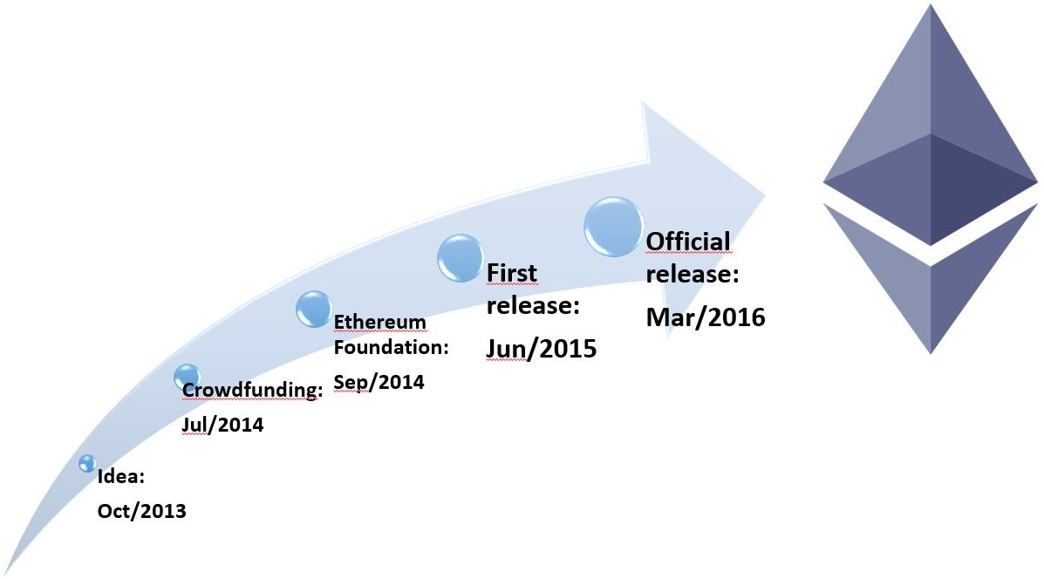

History of Ethereum - Timeline

Slide 4
Ethereum clients and releases
Various Ethereum clients have been developed using different languages and currently most popular are go-Ethereum and parity.
go-Ethereum was developed using Golang,
parity was built using Rust.
go-Ethereum client known as geth is sufficient for all purposes.
Mist is a user-friendly Graphical User Interface (GUI) wallet that runs geth in the background to sync with the network.

Slide 5
Ethereum clients and releases
The first release of Ethereum was known as Frontier
current release of Ethereum is called St. Petersburgh release.
The next release is named Istanbul .
The final release is named serenity, which is envisaged to have a Proof of Stake algorithm (Casper) implemented with it.
Other areas of research targeted with serenity include scalability, privacy, and Ethereum virtual machine (EVM) upgrade.

Slide 6
Ethereum clients and releases
This is a continuous development effort and the Ethereum ecosystem will undergo constant improvement and development
serenity should not really be considered a final version but a major milestone in a long journey of continuous improvement.
Further releases are envisaged but have not been named yet.
The vision of web 3.0 has already been proposed and is being discussed in the community.

Slide 7
Ethereum clients and releases
Web 3.0 is a concept that basically proposes a semantic and intelligent web as an evolution of the existing web 2.0 technology.
This is the vision of an ecosystem where people, applications, data, and web are all connected together and are able to interact with each other in an intelligent fashion.
With the advent of the blockchain technology, an idea of decentralized web has also emerged, which in fact was the original vision of the Internet.
The core idea is that all major services, such as DNS, search engines, and identity on the Internet will be decentralized in web 3.0.
This is where Ethereum is being envisaged as a platform that can help realize this vision.

Slide 8
The Ethereum stack
The Ethereum stack consists of various components.
At the core, there is the Ethereum blockchain running on the P2P Ethereum network.
Secondly, there's an Ethereum client (usually geth) that runs on the nodes and connects to the peer-to-peer Ethereum network
blockchain is downloaded and stored locally.
It provides various functions, such as mining and account management.
The local copy of the blockchain is synchronized regularly with the network.
Another component is the web3.js library that allows interaction with geth via the Remote Procedure Call (RPC) interface.

Slide 10
Ethereum blockchain
Ethereum, can be visualized as a transaction-based state machine.
The idea is that a genesis state is transformed into a final state by executing transactions incrementally.
The final transformation is then accepted as the absolute undisputed version of the state.

Slide 11
Transfer of 2 Ether from Address 4718bf7a to Address 741f7a2 is initiated

Slide 12
Currency (ETH and ETC)
As an incentive to the miners, Ethereum also rewards its native currency called Ether, abbreviated as ETH.
After the DAO hack a hard fork was proposed in order to mitigate the issue;
therefore, there are now two Ethereum blockchains:
Ethereum classic and its currency is represented by ETC
Hard-forked version is ETH, which continues to grow
ETC, however, has its own following with a dedicated community that is further developing ETC, which is the nonforked original version of Ethereum.

Slide 13
Forks
With the release of homestead, due to major protocol upgrades, it resulted in a hard fork.
The protocol was upgraded at block number 1,150,000, resulting in the migration from the first version of Ethereum known as Frontier to the second version of Ethereum called homestead.

Slide 14
Forks
A recent unintentional fork that occurred on November 24, 2016, at 14:12:07 UTC was due to a bug in the geth client's journaling mechanism.
Network fork occurred at block number 2,686,351.
This bug resulted in geth failing to revert empty account deletions in the case of the empty out-of-gas exception.
This means that from block number 2686351, the Ethereum blockchain is split into two, one running with parity clients and the other with geth.
This issue was resolved with the release of geth version 1.5.3.

Slide 15
Gas
Another key concept in Ethereum is that of gas.
All transactions on the Ethereum blockchain are required to cover the cost of computation they are performing.
The cost is covered by something called gas or crypto fuel,
This gas as execution fee is paid upfront by the transaction originators.
The fuel is consumed with each operation.

Slide 16
Gas
Each operation has a predefined amount of gas associated with it.
Each transaction specifies the amount of gas it is willing to consume for its execution.
If it runs out of gas before the execution is completed, any operation performed by the transaction up to that point is rolled back.
If the transaction is successfully executed, then any remaining gas is refunded to the transaction originator.

Slide 17
The consensus mechanism
The consensus mechanism in Ethereum is based on the GHOST protocol originally proposed by Zohar and Sompolinsky in December 2013
Ethereum uses a simpler version of this protocol,
where the chain that has most computational effort spent on it in order to build it is identified as the definite version.
Another way of looking at it is to find the longest chain, as the longest chain must have been built by consuming adequate mining effort.

Slide 18
The consensus mechanism
Greedy Heaviest Observed Subtree (GHOST) was first introduced as a mechanism to alleviate the issues arising out of fast block generation times that led to stale or orphan blocks.
In GHOST, stale blocks are added in calculations to figure out the longest and heaviest chain of blocks.
Stale blocks are called Uncles or Ommers in Ethereum.

Slide 20
The world state
The world state in Ethereum represents the global state of the Ethereum blockchain.
It is basically a mapping between Ethereum addresses and account states.
The addresses are 20 bytes long.
This mapping is a data structure that is serialized using Recursive Length Prefix (RLP).
RLP is a specially developed encoding scheme that is used in Ethereum to serialize binary data for storage or transmission over the network and also to save the state in a Patricia tree.
The RLP function takes an item as an input, which can be a string or a list of items, and produces raw bytes that are suitable for storage and transmission over the network.
RLP does not encode data; instead, its main purpose is to encode structures.

Slide 21
The account state
The account state consists of four fields:
nonce
balance
storageroot
codehash

Slide 22
The account state
Nonce
This is a value that is incremented every time a transaction is sent from the address.
In case of contract accounts, it represents the number of contracts created by the account.
Contract accounts are one of the two types of accounts that exist in Ethereum
Balance
This value represents the number of Weis which is the smallest unit of the currency (Ether) in Ethereum held by the address.

Slide 23
The account state
Storageroot
This field represents the root node of a Merkle Patricia tree that encodes the storage contents of the account.
Codehash
This is an immutable field that contains the hash of the smart contract code that is associated with the account.
In the case of normal accounts, this field contains the Keccak 256-bit hash of an empty string.
This code is invoked via a message call.

Slide 24
world state and its relationship with accounts trie, accounts, and block header

Slide 25
world state and its relationship with accounts trie, accounts, and block header
It shows the account data structure in the middle of the diagram,
which contains a storage root hash derived from the root node of the account storage trie shown on the left.
The account data structure is then used in the world state trie,
which is a mapping between addresses and account states.
Finally, the root node of the world state trie is hashed using the Keccak 256-bit algorithm and made part of the block header data structure,
which is shown on the right-hand side of the diagram as state root hash.

Slide 26
Accounts trie is basically a Merkle Patricia tree used to encode the storage contents of an account.
The contents are stored as a mapping between keccak 256-bit hashes of 256-bit integer keys to the RLP-encoded 256-bit integer values.

Slide 27
Transactions
A transaction in Ethereum is a digitally signed data packet using a private key that contains the instructions that
when completed, either result in a message call or contract creation.
Transactions can be divided into two types based on the output they produce:
Message call transactions:
This transaction simply produces a message call that is used to pass messages from one account to another.
Contract creation transactions:
As the name suggests, these transactions result in the creation of a new contract.
This means that when this transaction is executed successfully, it creates an account with the associated code.

Slide 28
Transactions
Both of these transactions are composed of a number of common fields
Nonce
Nonce is a number that is incremented by one every time a transaction is sent by the sender.
It must be equal to the number of transactions sent and is used as a unique identifier for the transaction.
A nonce value can only be used once.
gasPrice
The gasPrice field represents the amount of Wei required in order to execute the transaction.

Slide 29
gasLimit
The gasLimit field contains the value that represents the maximum amount of gas that can be consumed in order to execute the transaction.
This is the amount of fee in Ether that a user is willing to pay for computation
To
the to field is a value that represents the address of the recipient of the transaction.
Value
Value represents the total number of Wei to be transferred to the recipient;
in the case of a contract account, this represents the balance that the contract will hold.

Slide 30
Signature
Signature is composed of three fields, namely v, r, and s.
These values represent the digital signature (R, S) and some information that can be used to recover the public key (V).
Also of the transaction from which the sender of the transaction can also be determined
The signature is based on ECDSA scheme and makes use of the SECP256k1 curve.

Slide 31
Init
The Init field is used only in transactions that are intended to create contracts.
This represents a byte array of unlimited length that specifies the EVM code to be used in the account initialization process.
The code contained in this field is executed only once, when the account is created for the first time, and gets destroyed immediately after that.
Init also returns another code section called body, which persists and runs in response to message calls that the contract account may receive.
These message calls may be sent via a transaction or an internal code execution.

Slide 32
Data
If the transaction is a message call, then the data field is used instead of init, which represents the input data of the message call.
It is also unlimited in size and is organized as a byte array.

Slide 34
Transactions
Transaction is a tuple of the fields, which is then included in a transaction trie (a modified Merkle-Patricia tree)
Finally, the root node of transaction trie is hashed using a Keccak 256-bit algorithm and is included in the block header along with a list of transactions in the block.
Transactions can be found in either transaction pools or blocks.
When a mining node starts its operation of verifying blocks, it starts with the highest paying transactions in the transaction pool and executes them one by one.
When the gas limit is reached or no more transactions are left to be processed in the transaction pool, the mining starts.

Slide 35
Transactions
In this process, the block is repeatedly hashed until a valid nonce is found that, once hashed with the block, results in a value less than the difficulty target.
Once the block is successfully mined, it will be broadcasted immediately to the network, claiming success, and will be verified and accepted by the network.
This process is similar to Bitcoin's mining process
The only difference is that Ethereum's Proof of Work algorithm is ASIC-resistant, known as Ethash, where finding a nonce requires large memory.

Slide 36
Contract creation transaction
There are a few essential parameters that are required when creating an account
Parameters are listed as follows:
Sender
Original transactor
Available gas
Gas price
Endowment, which is the amount of ether allocated initially
A byte array of arbitrary length
Initialization EVM code
Current depth of the message call/contract-creation stack
current depth means the number of items that are already there in the stack

Slide 37
Contract creation transaction
Addresses generated as a result of contract creation transaction are 160-bit in length.
They are the rightmost 160-bits of the Keccak hash of the RLP encoding of the structure containing only the sender and the nonce.
Initially, the nonce in the account is set to zero.
The balance of the account is set to the value passed to the contract.
Storage is also set to empty.
Code hash is Keccak 256-bit hash of the empty string.

Slide 38
Contract creation transaction
The account is initialized when the EVM code (Initialization EVM code) is executed.
In the case of any exception during code execution, such as not having enough gas, the state does not change.
If the execution is successful, then the account is created after the payment of appropriate gas costs.
The version of Ethereum (homestead) specifies that the result of contract transaction is either a new contract with its balance, or no new contract is created with no transfer of value.

